Slide 1

Gaza Strip Reconstruction
Decision Support System (GSR-DSS)
AI-DRIVEN GEOSPATIAL INTELLIGENCE FOR POST-CONFLICT RECOVERY
Hamza Obaid
Ahmed Al-yazouri

Slide 2
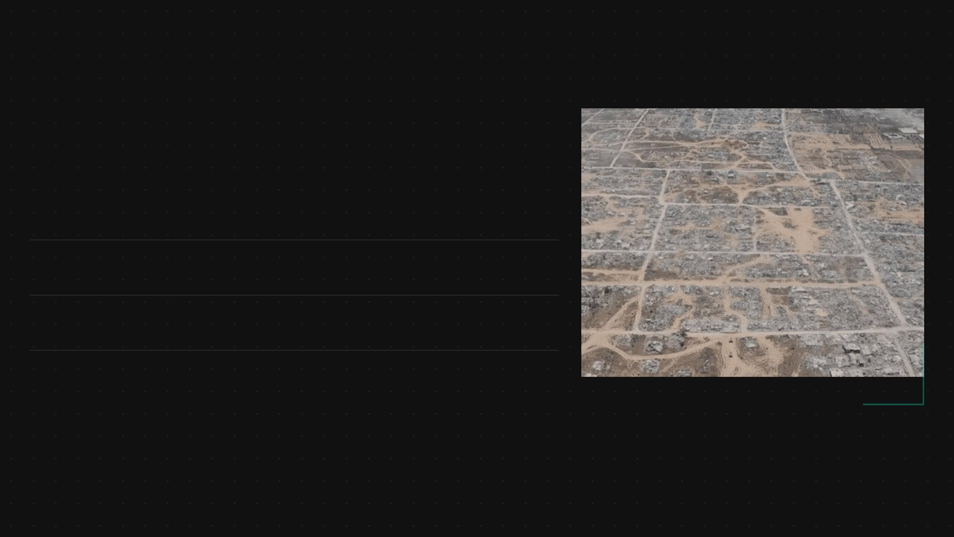
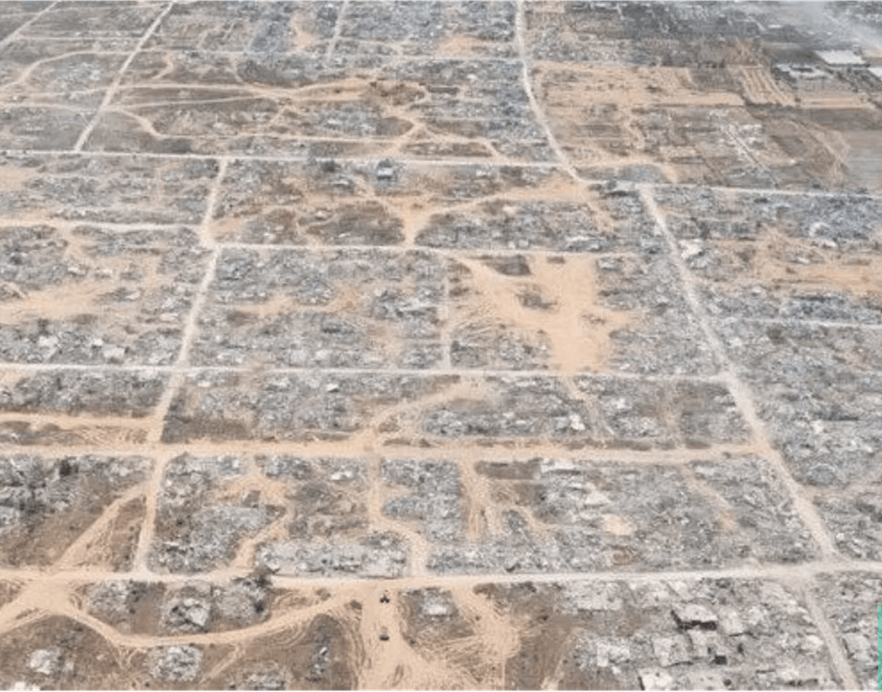



Data-Driven Recovery Optimizes Resource Allocation
The Gaza Strip Reconstruction Decision Support System (GSR-DSS) is a professional GIS platform designed for academic and humanitarian use. It transforms complex satellite-based damage data into a prioritized, actionable reconstruction roadmap.
Multi-Source Integration: Combines UNOSAT imagery, OpenStreetMap, and humanitarian population estimates.
Actionable Roadmap: Provides a robust framework for recovery through evidence-based spatial intelligence.
Version 1.0.0: Showcases advanced technical achievements in post-conflict recovery planning.
Aerial analysis of structural damage patterns

Slide 3

Multi-Stage Engineering Pipeline Ensures Data Integrity
The GSR-DSS follows a rigorous 5-step engineering pipeline to transform raw geospatial data into prioritized reconstruction intelligence.
01
Data Harmonization
Merging satellite imagery, OSM road networks, and UN OCHA humanitarian datasets.
02
Spatial Aggregation
Converting 198,308 damage points into 2,159 uniform 500m hexagonal analysis zones.
03
Feature Normalization
Standardizing diverse metrics (density, damage, infrastructure) into a 0-1 priority scale.
04
Network Topology
Analyzing connectivity importance using Edge Betweenness Centrality for all road segments.
05
Intelligent Scoring
Applying the AI scoring engine and K-Means clustering for final reconstruction classes.
The Data Loader initiates this process by preparing datasets and executing critical spatial joins (sjoin_nearest) to link projects with their nearest infrastructure references.

Slide 4

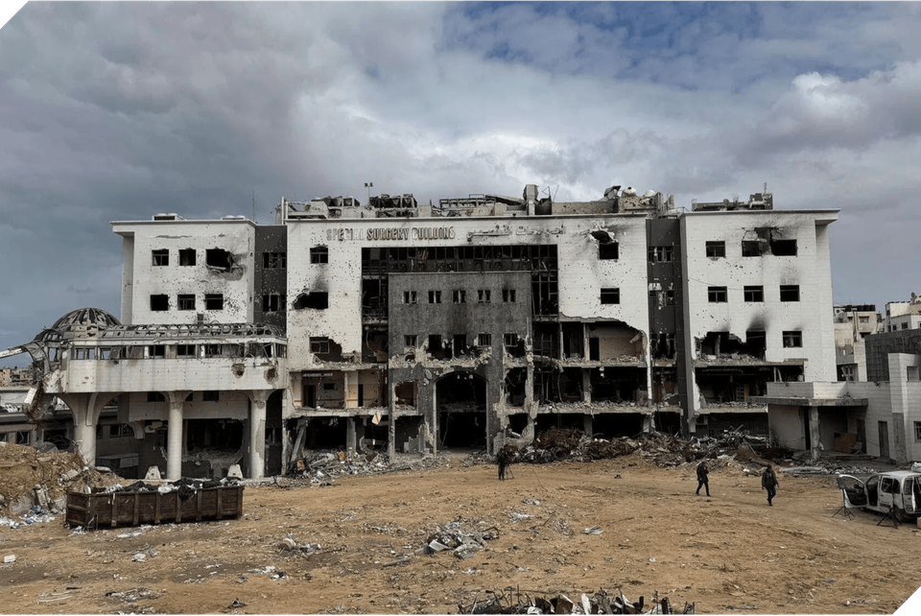
Strategic AI Scoring Prioritizes Critical Infrastructure
The core Multi-Criteria Decision Analysis (MCDA) engine utilizes a Weighted Linear Combination (WLC) formula to determine reconstruction priorities, ensuring survival and emergency response are at the forefront.
Criteria
Weight (w)
Strategic Justification
0.60
Critical for survival and emergency response.
Major Hospitals
0.20
Physical requirement for reconstruction.
Damage Severity
0.20
Prioritizes long-term suffering areas.
Temporal Persistence
Impact analysis: Healthcare infrastructure damage
0.15
Maximizes the number of direct beneficiaries.
Population Density
Score = Σ (w_i × x_i) · α
Weighted Linear Combination with Non-Linear Activation

Slide 5

Spatial Join Analysis Identifies Strategic Healthcare Life-Lines
The system employs advanced spatial join techniques to prioritize medically sensitive roads based on their proximity to healthcare facilities. This practical GIS analysis ensures that critical emergency routes are identified and prioritized for immediate intervention.
Proximity to Hospital
Strategy Adjustment
Priority Level
Within 500m
Strategic Score = 5
Critical Access
500m - 1000m
Strategic Score = 3
High Priority
Beyond 1000m
Standard Scoring
Secondary Access
Each road segment is assigned to the nearest hospital with a distance_to_hospital value. Roads within the 500m threshold are flagged as near_hospital=True, triggering a maximum priority boost in the reconstruction roadmap.
SPATIAL_JOIN_ENGINE_V1.0 GIS_DISTANCE_ANALYSIS_ACTIVE [STATUS: MAPPING_CRITICAL_ACCESS]

Slide 6

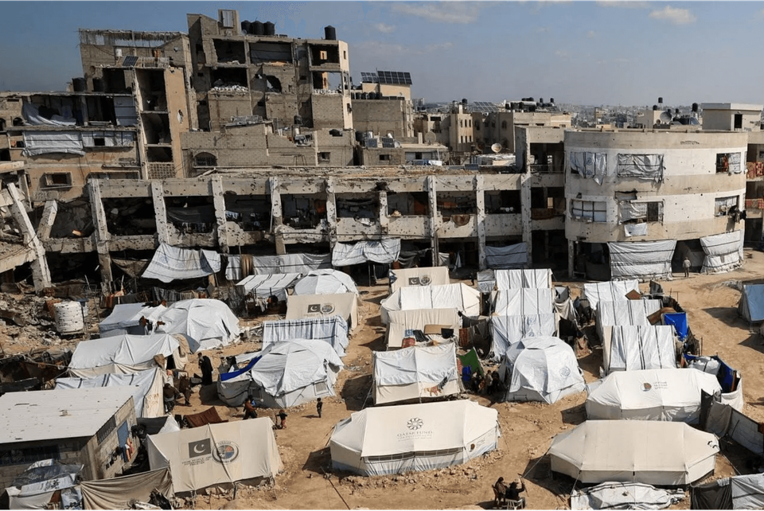
Dynamic Population Models Map Current Concentrations
Baseline data from WorldPop 2020 has been adjusted using UN OCHA displacement estimates for 2025 and 2026 to reflect current ground realities. The model accounts for the massive population shift from high-destruction zones to reception hubs.
Region / Zone
Population Trend
Current Status
Nuseirat / Al-Zawayda
2.5x Increase
Primary IDP Hubs
West Khan Yunis
High Concentration
Dense Urban Centers
Al-Zawayda
35,000 people/km²
Extreme Density Spike
Jabalia / Beit Hanoun
95% Displaced
Semi-Vacated / High Damage
Analysis of current displacement and reception hub patterns
The model prioritizes reconstruction in Central and Southern hubs where the population is currently concentrated, while maintaining strategic planning for return to the Northern zones as security and clearance allow.

Slide 7

UNSUPERVISED MACHINE LEARNING CATEGORIZES HOTSPOTS
Unsupervised learning, specifically K-Means Clustering, was applied to all hex zones to group areas with similar reconstruction conditions into functional cluster profiles. This provides a clearer, data-driven view of where and how recovery efforts should be prioritized.
CLUSTER PROFILE
PRIMARY FOCUS
STRATEGIC OBJECTIVE
Critical Infrastructure Hubs
Systemic Rebuilding
Restore high-impact infrastructure nodes and connected lifelines first.
High Density / High Damage
Urban Emergency Recovery
Prioritize severely damaged, highly populated zones for immediate intervention.
Service Hubs Under Pressure
Essential Services Continuity
Stabilize healthcare, water, and utility access in stressed areas.
Algorithm: K-Means Clustering | Feature Set: Damage Intensity, Population Density, Infrastructure Proximity

Slide 8

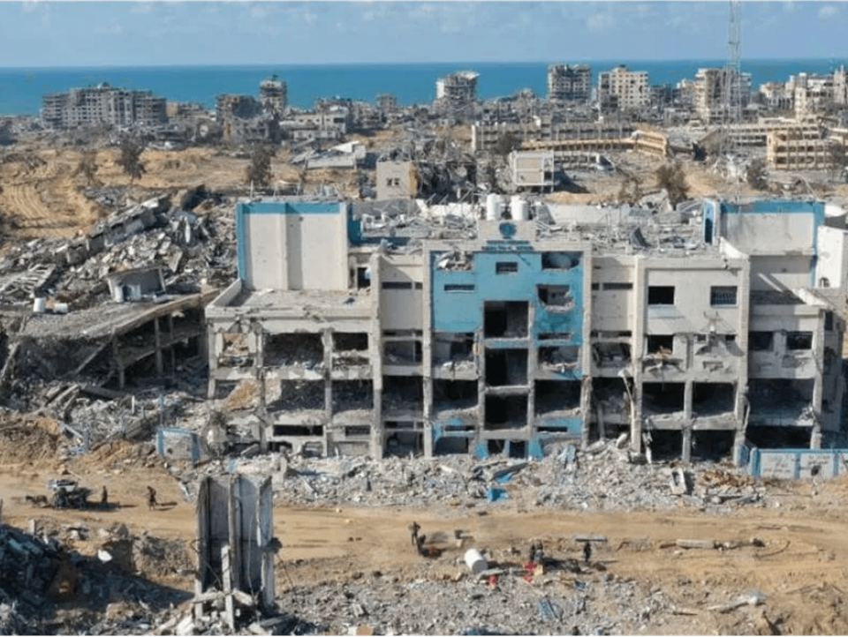
Phased Implementation Strategy Ensures Recovery Success
Phase 1: Immediate Recovery
Months 0-12
Focuses on hospitals, arterial roads, and essential water/utility infrastructure to stabilize the humanitarian situation.
Phase 2: Short-Term Stabilization
Months 13-36
Targets high-density residential areas and primary educational centers to support returning populations.
Phase 3: Medium-Term Expansion
Months 37-60
Expands to secondary road networks and municipal service buildings to restore local governance and mobility.
Phase 4: Long-Term Restoration
Months 61-84
Visual monitoring of phased reconstruction milestones
Completes the restoration of residential neighborhoods and long-term economic zones for sustainable growth.
Total Project Duration: 84 Months (7 Years) | Strategic Phasing based on Population Density and Infrastructure Criticality.

Slide 9




Comprehensive Digital Outputs Facilitate Stakeholder Coordination
To support diverse stakeholders, the GSR-DSS generates automated outputs that facilitate evidence-based decision-making across all levels of administration.
Interactive Maps
Project Portfolios
Automated Reports
3D damage visualizations and heatmaps for intuitive spatial understanding and site-specific planning.
Detailed portfolios listing 175 projects, each linked to the nearest spatial reference (e.g., hospital) via spatial joins.
Tailored municipality reports and statistical dashboards providing localized intelligence for governance.
175
25+
100%
Priority Projects
Automated Reports
Data Consistency
OUTPUT_GENERATION_ENGINE_V1.0 // STATUS: ALL_SYSTEMS_OPERATIONAL

Slide 10

Future Roadmap Enhances Real-Time Decision Support
Q2 2026
Q3 2026
Q4 2026
Web-GIS Interface
Live Data Integration
ML Cost Prediction
Launch of a collaborative platform for broader stakeholder access and interactive planning tools.
Real-time synchronization with UN OCHA and humanitarian feeds to update priority scores dynamically.
Implementation of advanced Machine Learning models for accurate, dynamic reconstruction cost forecasting.
The GSR-DSS remains a living framework, evolving with the ground reality to support a resilient future for Gaza. These enhancements will ensure the system remains a critical tool for evidence-based recovery.
SYSTEM_EVOLUTION_PROTOCOL_INITIATED // ROADMAP_VER_2026.4 // [STATUS: READY_FOR_SCALING]

